Slide 1
Time and Space Requirements

Slide 2
Basics
Algorithm:
  For any particular application
    Choose the data structure
    Develop an algo to manipulate the data items
    It is a step-by-step finite sequence of instructions, to solve a well-defined computational problem.
Features of an Algorithm
  Should be free of ambiguity
  Should be concise
  Should be efficient

Slide 3
Basics…
Every algo should satisfy the following criteria:
Input: zero/more
Output : atleast one
Definiteness: each instruction – clear and unambiguous.
Finiteness : for all cases, it has to terminate after a finite no. of steps.
Effectiveness: every instruction must also be feasible.

Slide 4
Algo Design Techniques
Top-down design:
Divide a program into a main module and its related modules.
Subdivide each module further into smaller and smaller modules – each module has elementary processes – understood easily and cannot be further subdivided.
Ex: Problem solving using C

Slide 5
Algo Design Techniques
Bottom-up design :
An application is constructed from the existing primitives of the language.
Gradually construct more and more complex features
Use : for testing – lowest level functions are written and tested first.
Then the next level functions are tested.
Process continues until the main function is tested.

Slide 6
Algo design approaches
Incremental :
Ex: insertion sort
Having sorted subarray[1…j-1], the algo inserts a[j] appropriately giving the sorted subarray[1…j]
Divide and Conquer Approach:
Divide the original problem into a set of sub-problems
Solve every sub problem separately, recursively
Combine their solutions into a solution of the whole original problem
Ex : quick-sort, merge-sort, multiplying large numbers

Slide 7
Algo design approaches…
Greedy:
Try to optimise a function based on a local criteria.
Give a good solution, not necessarily the best one.
At each phase:
The algo takes the best it can at that moment, without regard for future consequences.
Never reconsiders its earlier decisions.
Hope that by choosing a local optimum at each step, will end up at a global optimum.
Ex: determining minimum no. of coins to give while making change.

Slide 8
Algo design approaches…
Dynamic programming:
Solving complex problems by breaking them into simpler subproblems.
Mainly used in problems with the property of overlapping subproblems.
Each subproblem is solved once and its solution is stored or memo-ized.
Next time when the solution is needed, it is simply looked up.
Ex: computing the nth fibonacci number

Slide 9
Algo design approaches…
Branch and bound –
  Used to find an optimal solution from a set of solutions.
  uses a systematic enumeration of all candidate solutions
  Discards fruitless candidate solutions using the upper and lower bounds of the quantity being optimized.
  Ex: Travelling salesman problem
Randomized algo – use a degree of randomness in their logic
Backtracking

Slide 10
Analysis of Algos
To predict its correctness – analysis – measures its efficiency
Methods for analysing algos: (T1 1.1 – 1.4)
Experimental Framework :
The running time :
  Execute it on various test inputs and record the actual time spent in each execution.
  Use system calls built into the language or the OS for which the algo is written
  Visualize the results :
    Plot a graph :
    x axis - input size, n
    Y axis – running time, t

Slide 11
Running time increases with the input size.
It may vary with distinct inputs of the same size.
It is also affected by the hardware environment (processor, memory, disk, etc)
It is also affected by the software environment (OS, programming language, compiler, etc)
Limitations of running time:
Not possible to experiment on all possible test inputs
Test inputs – best representatives
To compare the efficiency of two algos using their running time, use same hardware and software environments.
Necessary to implement and execute an algo to study its running time.

Slide 12
Analytic Framework:
Takes into account all possible inputs
Allows us to evaluate the relative efficiency of two algos, independent of the h/w and s/w environments
Can be done without implementing the algo – using its high-level description.
It associates a function f(n) with each algo – defines its running time in terms of the input n.

Slide 13
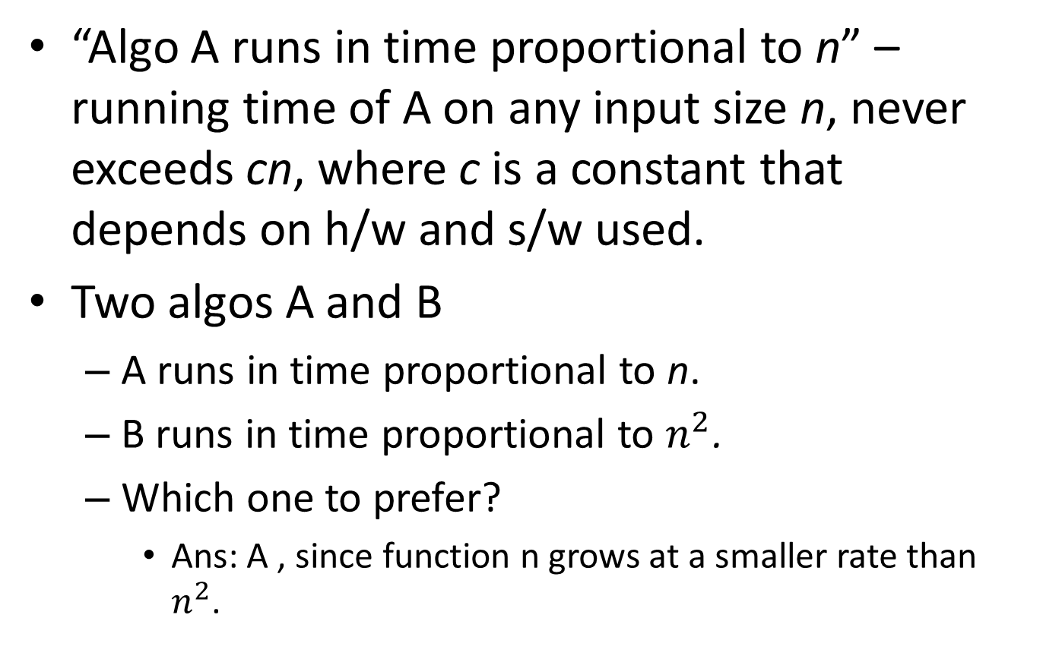
“Algo A runs in time proportional to n” – running time of A on any input size n, never exceeds cn, where c is a constant that depends on h/w and s/w used.
Two algos A and B
  A runs in time proportional to n.
  B runs in time proportional to $n^{2}$.
  Which one to prefer?
    Ans: A , since function n grows at a smaller rate than $n^{2}$.

Slide 14
Methodology for algo analysis
Requires
  A language for describing the algo
  A computational model that algos execute within
  A metric to measure its running time
  An approach for characterizing the running times.

Slide 15
  Pseudo-code : A language for describing the algo
Are descriptions that are :
  Not computer programs
  More structured than usual prose.
  Facilitate the high-level analysis of a data structure/algo.
  Easier to read and understand
  Is a mixture of natural language and high-level programming constructs
  Are used to analyse the correctness of an algo

Slide 16
Pseudo-code…
High-level constructs used in a Pseudo-code:
Expressions:
  std mathematical symbols – boolean and numeric expressions
  ⟵ for assignment
  = for equality relation
Method Declarations:
  Algorithm name(param1, param2,….)
Decision Structures:
if condition then true-actions else false actions.

Slide 17
Pseudo-code…
While-loops:
    While condition do actions
Repeat-loops
  repeat actions until condition
For loops:
  for variable-increment-definition do actions
Array indexing : A[i] represents the ith cell in array A. Indexed from A[0] to A[n-1]
Method calls: object.method(args). Object is optional if understood.
Method returns : return value

Slide 18
Pseudo-code….
Ex : finding the maximum element in an array A having n integers
Algorithm arrayMAx(A,n):
Input: An array A storing n⩾1 integers.
Output : the maximum element in A
currentMax ⟵ A[0]
for i = 1 to n-1 do
if currentMax < A[i] then
currentMax ⟵ A[i]
return currentMax

Slide 19
How to analytically characterize algos in Pseudo-code
Determine the running time analytically.
Count the no. of primitive operations.
Primitive operations:
Operations whose execution time depends on h/w and s/w environment but not constant.
The no. of primitive operations in an algo , is proportional to its running time.

Slide 20
Primitive operations are:
  Assigning a value to a variable
  Calling a method
  Performing an arithmetic operation
  Comparing two numbers
  Indexing into an array
  Following an object reference
  Returning from a method

Slide 21
Methodology for algo analysis
Requires
  A language for describing the algo
  A computational model that algos execute within
  A metric to measure its running time
  An approach for characterizing the running times.

Slide 22
RAM Machine Model Definition
Computational model within which algos execute
Computer is a CPU connected to a set of memory cells.
A number, a character string or an address.
The CPU in the RAM does a primitive operation in constant no. of steps, irrespective of input size.
The no. of primitive operations in an algo corresponds directly to its running time.

Slide 23
Counting primitive operations
Example arrayMax:
currentMax ⟵ A[0]
  [ 2 units. Indexing and assigning]
At the beginning of the loop i is initialised to 1
  [1 unit. Assignment]
Before entering the loop i < n is verified.
  [1 unit. comparison. This is done n times at the end of each iteration]

Slide 24
Body of the loop n-1 times.
In each iteration
  A[i] is compared with currentMax – 2 units –indexing and comparison
  If A[i] is assigned to currentMax – 2 units – indexing and assignment
  i is incremented – 2 units – summing and assigning
So, in each iteration 4 or 6 operations are done.
Body of the loop contributes to 4(n-1) or 6(n-1) units

Slide 25
Returning the value of currentMax – 1 unit
So, the no. of primitive operations t(n) executed by the algo is atleast:
2 + 1 + n + 4(n-1) + 1 = 5n
Atmost : 2 + 1 + n + 6(n-1) + 1 = 7n – 2
Best Case : t(n) = 5n occurs, when A[0] is the max.
Worst Case : t(n) = 7n – 2 occurs when the elements are sorted in ascending order

Slide 26
Advantages of using worst case Analysis:
An algo may run faster on certain data sets than the others.
Finding the average case can be very difficult, so typically algorithms are measured by the worst case time complexity.
Also, in certain application domain – air traffic control, surgery – knowing the worst case time complexity is of crucial importance.
Just requires the ability to identify the worst case input.
Designing for worst case can lead to better algos.

Slide 27
Growth rate of running time
Algorithm arrayMax executes 7n – 2 no. of primitive operations in the worst case.
Define
a = time taken by the fastest primitive operation
b =time taken by the slowest primitive operation
Let T(n) be the worst case time of arrayMax. Then
a(7n – 2) ⩽ T(n) ⩽ b(7n – 2)
Hence, the running time T(n) is bounded by two linear functions.
Changing the h/w or s/w
  Affects T(n) by a constant factor, but
  Does not alter the growth rate of T(n)

Slide 28
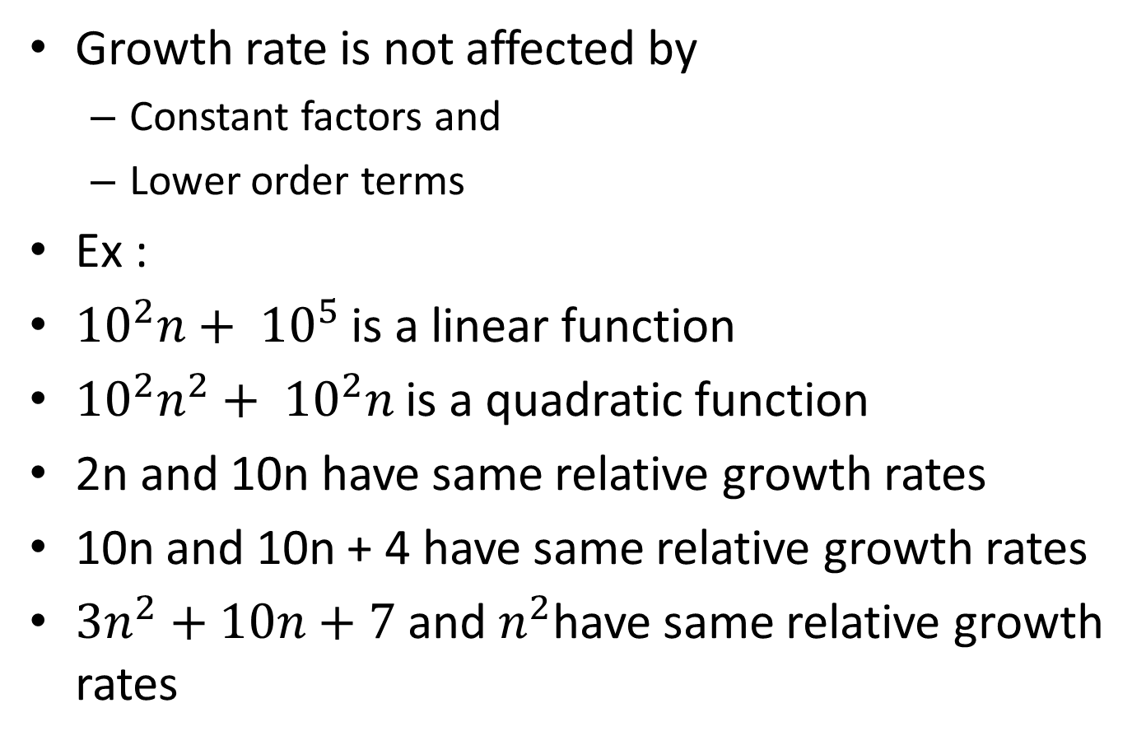
Growth rate
Growth rate is not affected by
  Constant factors and
  Lower order terms
Ex :
${10}^{2}n+ {10}^{5}$is a linear function
${10}^{2}n^{2}+ {10}^{2}n$ is a quadratic function
2n and 10n have same relative growth rates
10n and 10n + 4 have same relative growth rates
${3n}^{2}+10n+7$ and $n^{2}$have same relative growth rates

Slide 29
Analyzing Recursive Algos
Two techniques of solving a problem are :
  Iteration
  Recursion
Recursion :
  A procedure P calls itself.
  Each call to P is used to solve a sub problem of smaller size – recursive calls
  Base case : is a small problem which can be solved without recursion.

Slide 30
Example
Base Case : when n = 1, return A[0] as max
Recursive : compute largest of first n-1 elements recursively, and return max of this and the last element of the array.
Algorithm recursiveMax(A,n):
Input : An array A storing n⩾ 1 integers.
Output : The maximum element in A.
if n = 1 then
return A[0]
return max{recursiveMax(A,n-1), A[n – 1]}

Slide 31
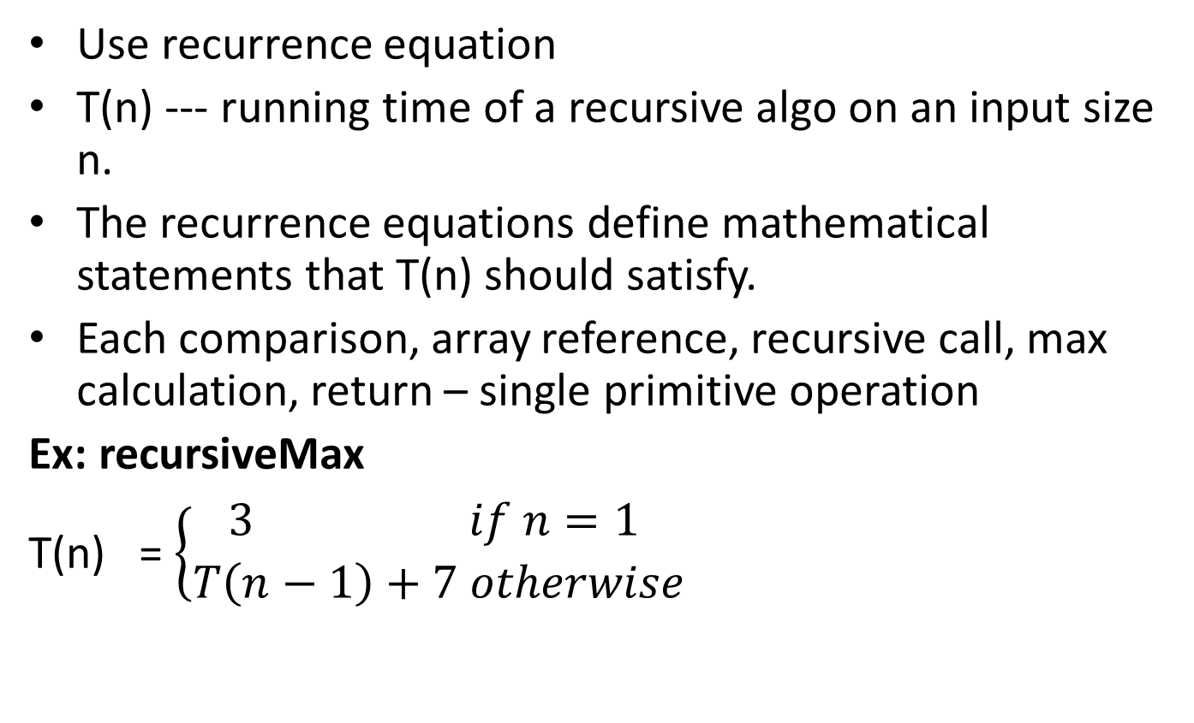
Running time of recursive algos
Use recurrence equation
T(n) --- running time of a recursive algo on an input size n.
The recurrence equations define mathematical statements that T(n) should satisfy.
Each comparison, array reference, recursive call, max calculation, return – single primitive operation
Ex: recursiveMax
T(n) = $\left\{\begin{aligned}3 if n=1 \\ T\left(n−1\right)+7 otherwise\end{aligned} \right.$

Slide 32
Closed form : without references to T(n) on the right side :
T(n) = 7(n-1) + 3. = 7n – 4.

Slide 33
Asymptotic Notation
Allows to characterize an algo’s running time ignoring the implementation depending factors.
To perform aysmptotic analysis :
  Find the worst case no. of primitive operations executed as a function of the input size.
  Express this function in Big – Oh notation

Slide 34
The “Big-Oh” Notation:
A formal method of expressing the upper bound of an algo’s running time.
It is a measure of the longest amount of time that could possibly take for the algo to complete.

Slide 35
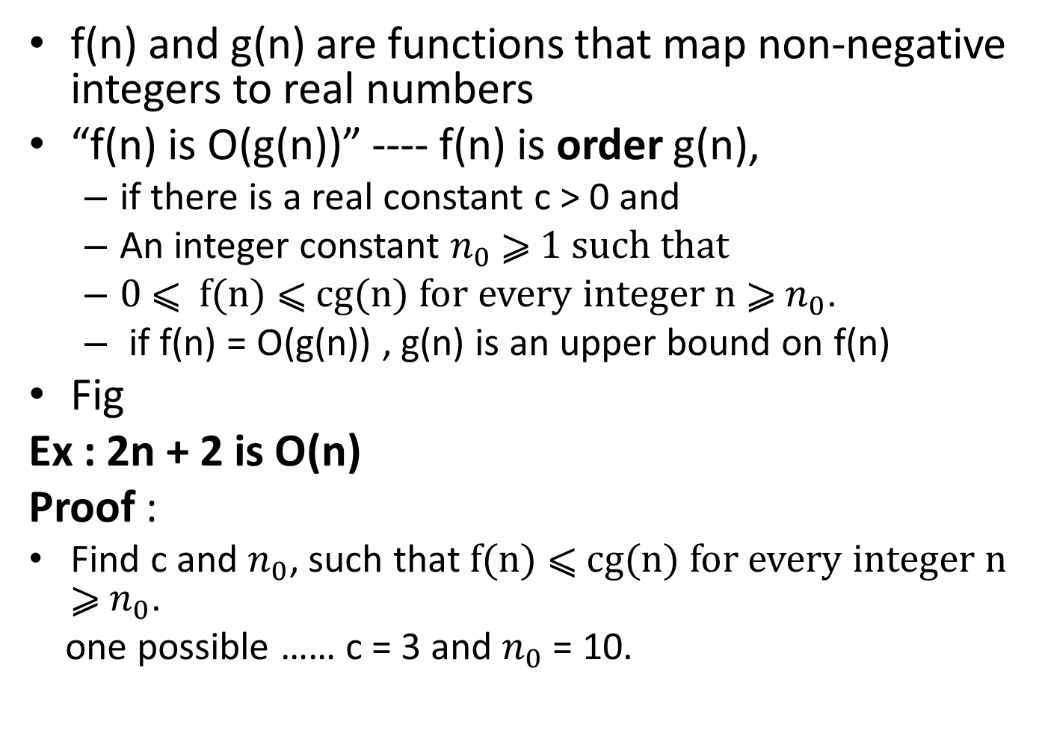
f(n) and g(n) are functions that map non-negative integers to real numbers
“f(n) is O(g(n))” ---- f(n) is order g(n),
  if there is a real constant c > 0 and
  An integer constant $n_{0}$ ⩾ 1 such that
  0 ⩽ f(n) ⩽ cg(n) for every integer n ⩾ $n_{0}$.
  if f(n) = O(g(n)) , g(n) is an upper bound on f(n)
Fig
Ex : 2n + 2 is O(n)
Proof :
  Find c and $n_{0}$, such that f(n) ⩽ cg(n) for every integer n ⩾ $n_{0}$.
  one possible …… c = 3 and $n_{0}$ = 10.

Slide 36
Ex : Running time of arrayMax is O(n)
Proof :
Running time = 7n – 2
7n – 2 ⩽ 7(n), for c = 7 and n⩾ 1
So, Running time of arrayMax is O(n)
n | 7n – 2 | 7(n)
1 | 5 | 7
2 | 12 | 14
3 | 19 | 21
: | : | :

Slide 37
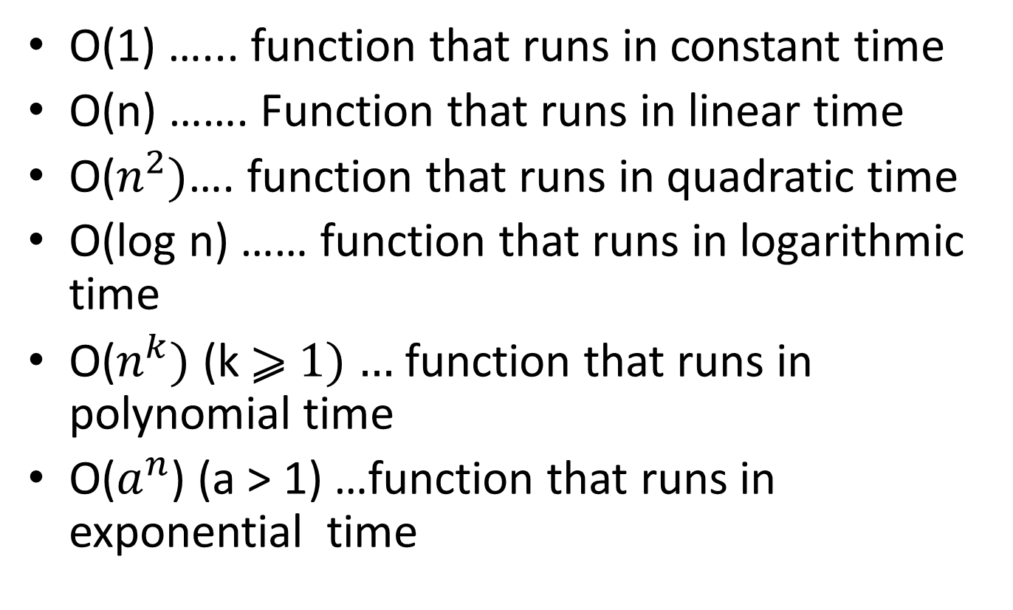
Common terms used in Algo analysis
O(1) …... function that runs in constant time
O(n) ……. Function that runs in linear time
O($n^{2})$…. function that runs in quadratic time
O(log n) …… function that runs in logarithmic time
O($n^{k})$ (k ⩾ 1) … function that runs in polynomial time
O($a^{n}$) (a > 1) …function that runs in exponential time

Slide 38
Big-Oh growth rate
Big-Oh rules
Relatives of Big-Oh
Computing prefix averages

